Slide 1
Condition of Startups worldwide
Startups
August 2026

Slide 2
Table of Contents
Problem statement
KPI
Conclusion
Summary
Recommendation

Slide 3
Business Problem
Venture capital firms and startup founders need a data-driven evaluation of the global startup ecosystem to identify high-performing geographic markets, thriving industry sectors, and key investment drivers. Without this analysis, stakeholders lack visibility into where capital is most concentrated, which regions offer the highest funding potential, and how sector distribution varies worldwide, leading to misallocated resources and missed expansion opportunities.

Slide 4
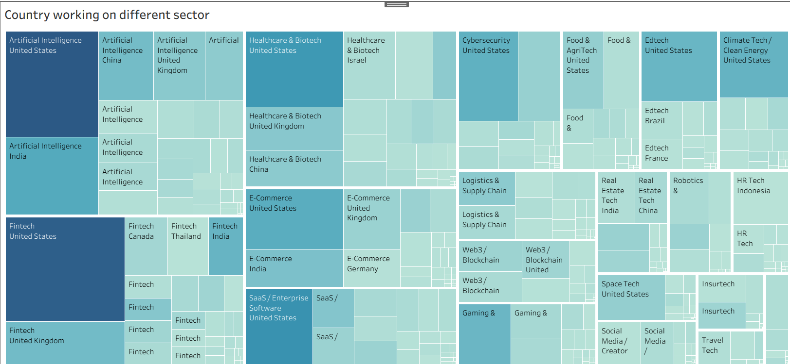
KPI

Slide 5
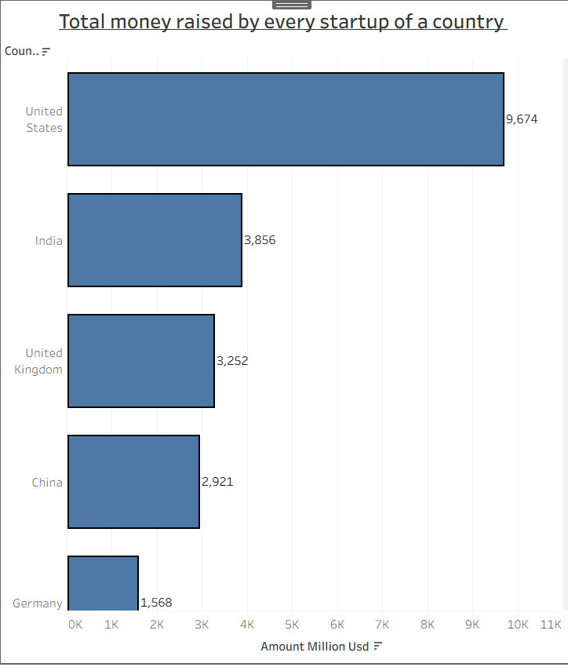
KPI

Slide 6
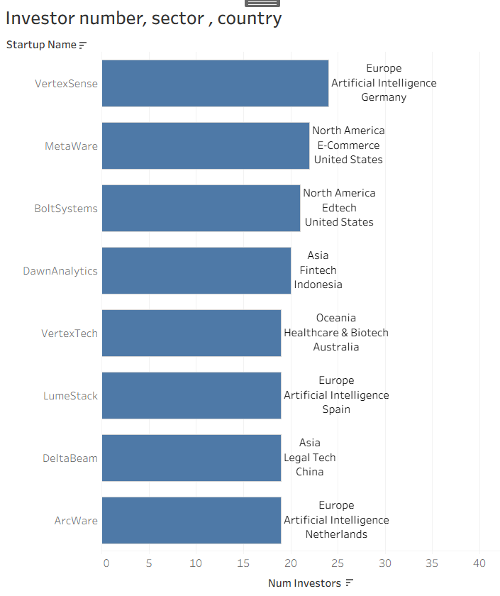
KPI

Slide 7
CONCLUSION
The analysis proves that the United States is the primary global hub for startup activity, dominating total capital investment, investor count, and sector diversification. Conversely, emerging regions like Bangladesh show sparse market participation. Stakeholders can use these insights to target high-value ecosystems while conducting localized qualitative surveys for underrepresented regions.

Slide 8
SUMMARY
Objective: Evaluated the global startup ecosystem using multi-source data to identify high-performing geographic hubs, sector distributions, and funding trends.
Methodology: Cleaned and processed multi-table datasets, executed complex SQL queries (JOIN, GROUP BY, MAX, COUNT), and built interactive Tableau visualizations (treemaps and bar charts).
Key Findings: Revealed that the United States leads globally in capital accumulation, investor engagement, and sector diversity, while regions like Bangladesh require localized market surveys.
Outcome: Delivered a complete, end-to-end data analytics portfolio case study satisfying all core business requirements.

Slide 9
RECOMMENDATION
Prioritize High-Value Markets: Allocate core venture capital and major expansion resources toward established, high-performing hubs like the United States, where investor engagement and funding volumes are maximized.
Conduct Localized Market Research: Implement qualitative local surveys and ground-level discovery initiatives in underrepresented regions (such as Bangladesh) to uncover niche sectors and overcome data gaps before committing capital.
Diversify Portfolio Sectors: Balance investments across high-growth, high-concentration categories (like Artificial Intelligence and Fintech) while exploring emerging opportunities in specialized regional domains.

Slide 10
Thank you

